Slide 1



Innovation Geeks
EduPulse AI From student’s feedback to AI powered strategy

Slide 2
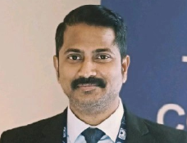
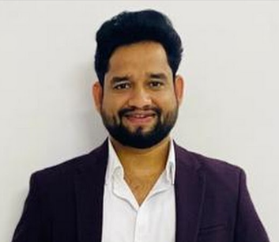


Theme: Development of an interactive application using Microsoft Power Apps and Azure AI Services to enhance organizational strategy building for upcoming training sessions over the next 2–3 years.
Team Innovation Geeks
Dr. Kiran Naidu,
Data Scientist
Vijay Sanku,
IT Manager
⁠Jacques Stephan,
Head of Regulatory Compliance and Sanctions
P
Swapnil Bandwal,
Cloud Architect
Hackathon challenges and opportunities
Business Impact
Creativity & Innovation
Objective:
Developing an interactive application utilizing Microsoft Power Apps and Azure AI Foundry Services is proposed, with the immediate objective of creating a Minimum Viable Product (MVP).
Problem Statement:
Manual Feedback Analysis
Delayed Insights
Lack of Visibility
Concept:
Enables real-time insights into learner sentiments.
Helps course creators and mentors personalize and improve content.
Empowers data-driven decisions for learner engagement.
Potential Benefits:
Improve Learner Satisfaction: Act on real-time, AI-driven insights
Empower Mentors: Enable personalized coaching based on learner sentiment.
Reduce Manual Effort: Automation reduces hours of manual feedback analysis.
Advanced AI-powered sentiment analysis for nuanced insights
Composable Architecture: Easily extendable with MS Products
Low-Code + AI Fusion Rapidly deployable, scalable system using Power Platform.
Hyper-Personalization: Tailor learning experiences with intelligent feedback loops.

Slide 3
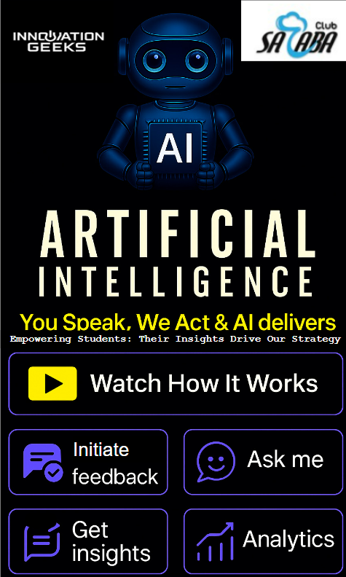
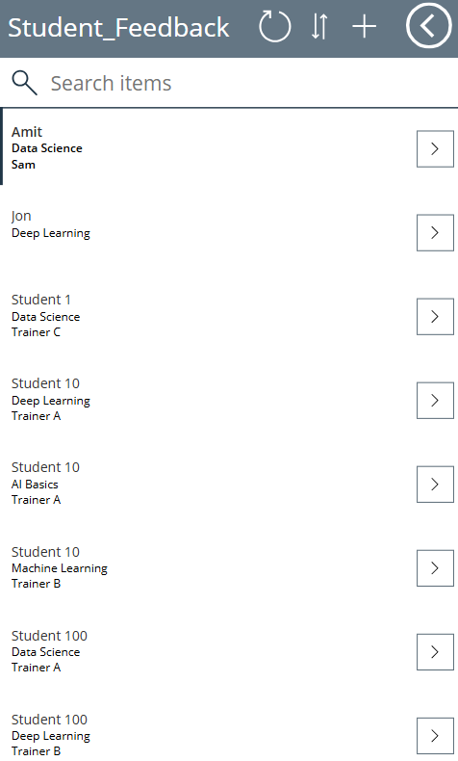
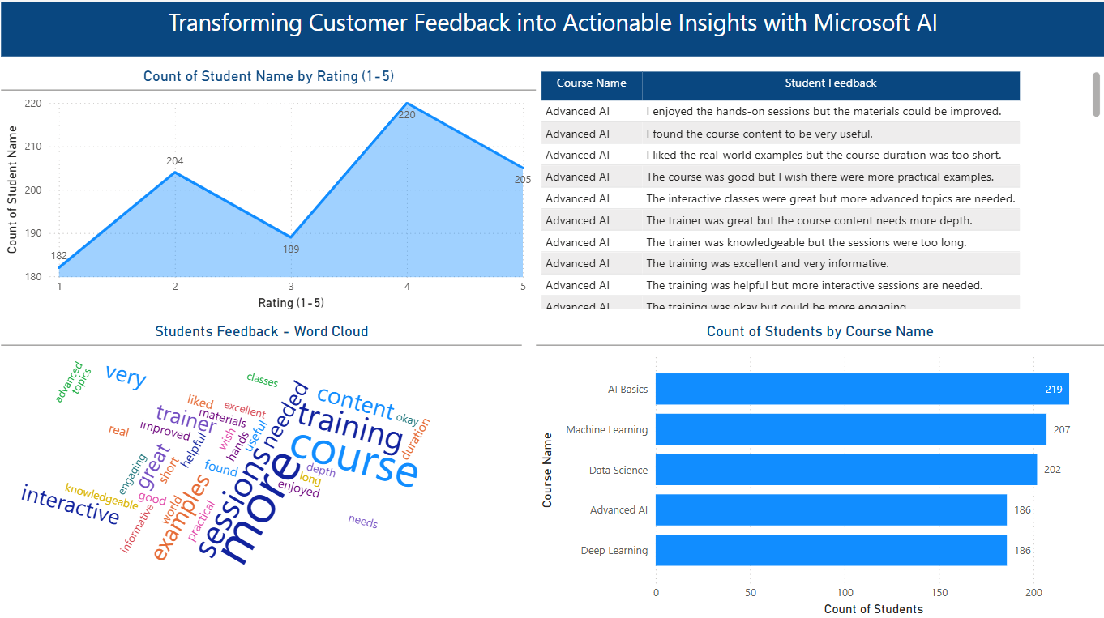
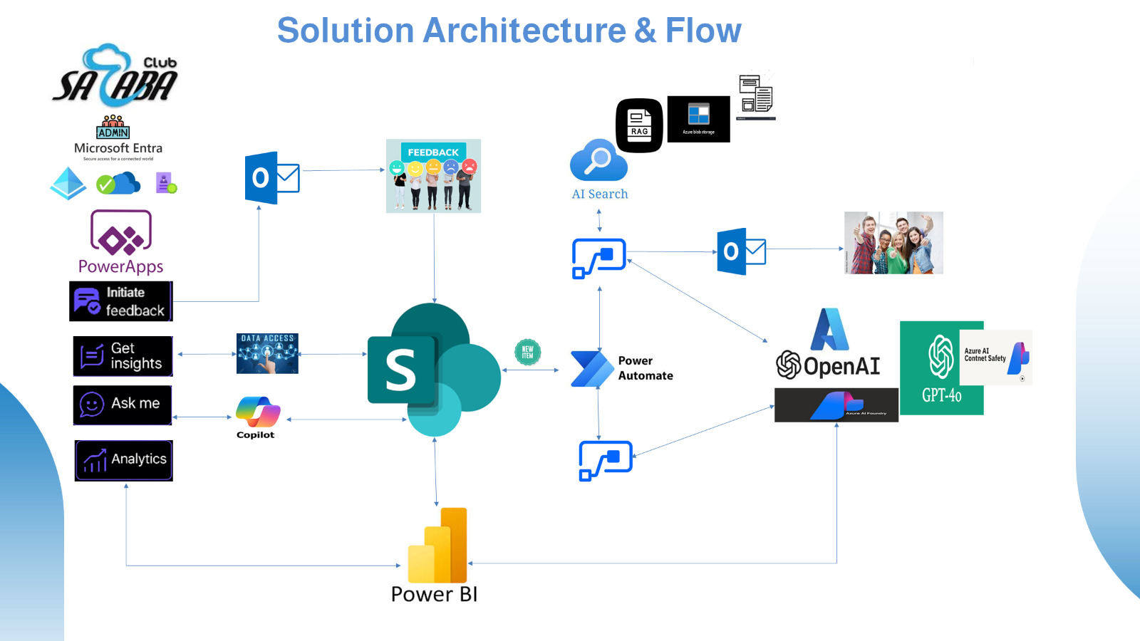
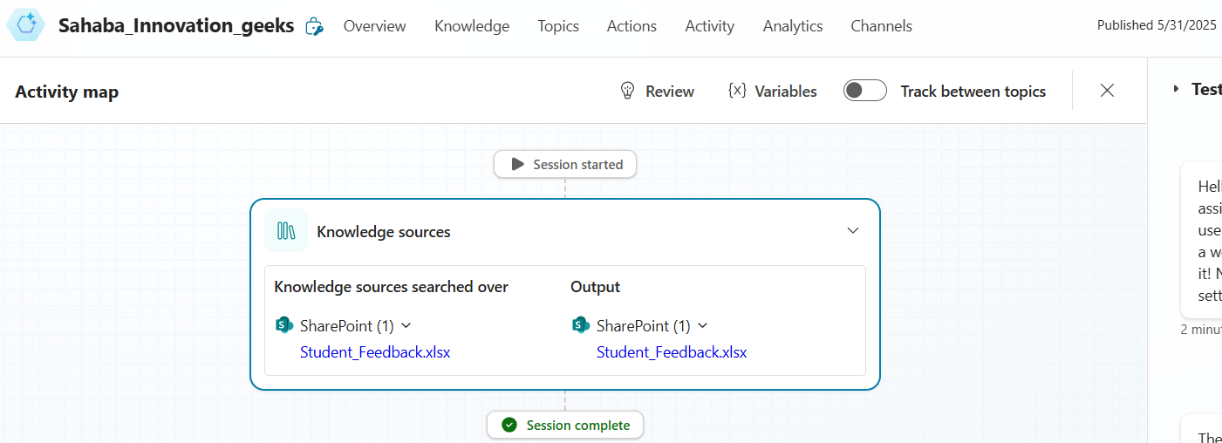
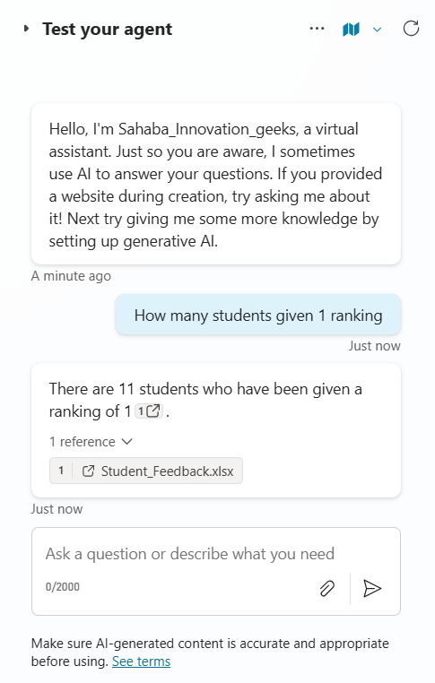
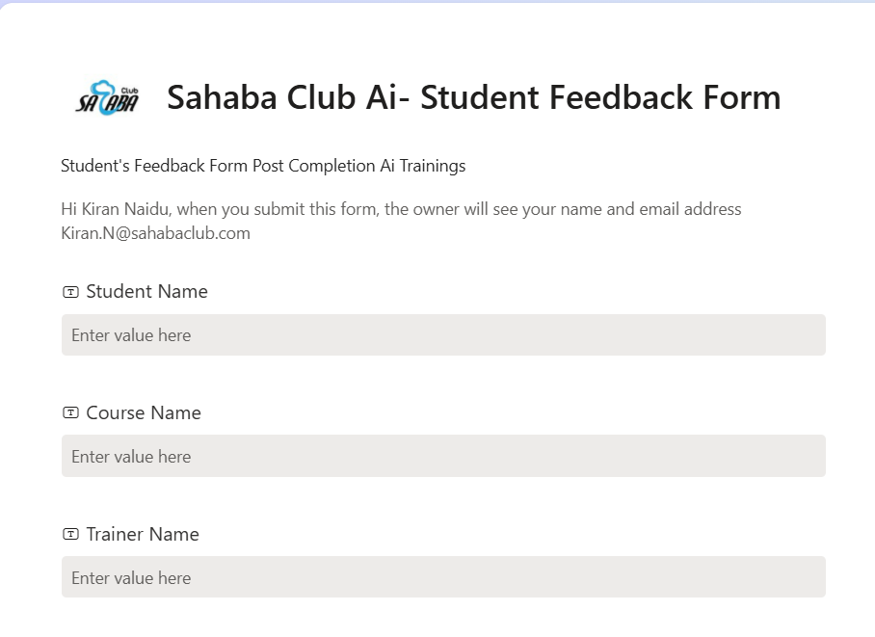
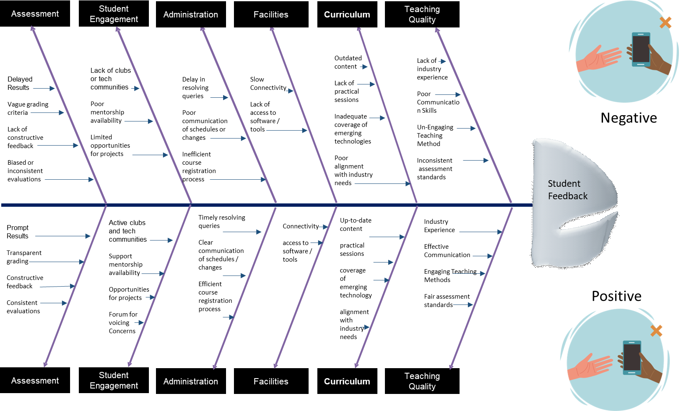
Key Deliverables For this Hackathon:
Power App Design
MS Power BI
MS Azure Foundry
Power App
Power Bi
MS Co Pilot Studio- Agent
Feedback Form
Lean Six Sigma- RCA
Sahaba Club Ai- Student Feedback Form

Slide 4




























EduPulse AI - Solution Architecture & Flow
Architecture & Flow – Incident Management
Tools Used:
MS Power Platform
MS Power BI
Power App
MS Power Automate
Co Pilot Studio Agent
MS Email
MS SharePoint
MS List
Azure Ai Foundry
RAG
Ai Services
Vector DB-Azure Ai Search
I
RAG

Slide 5
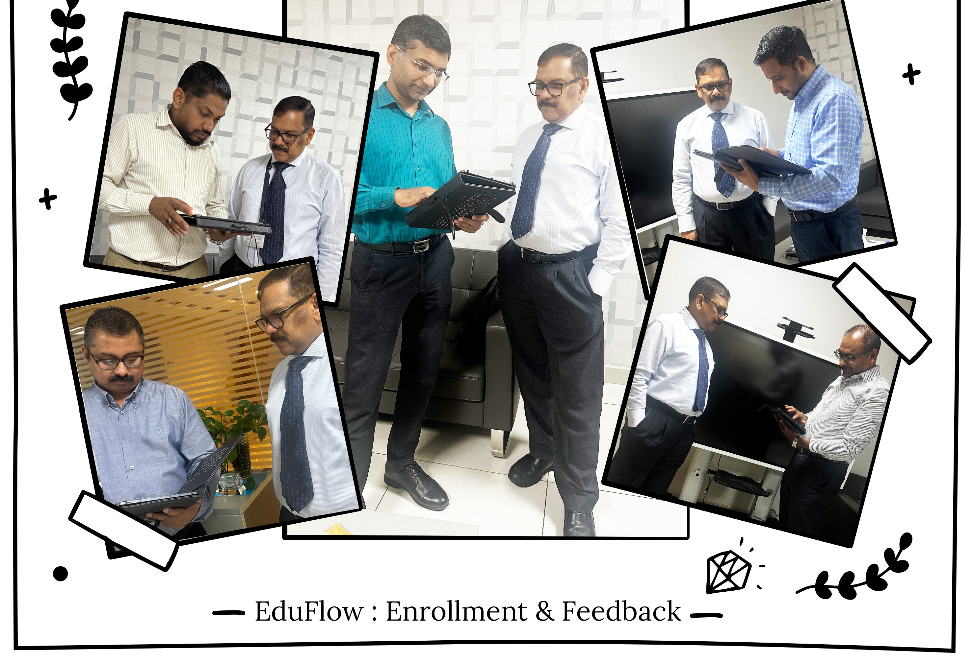
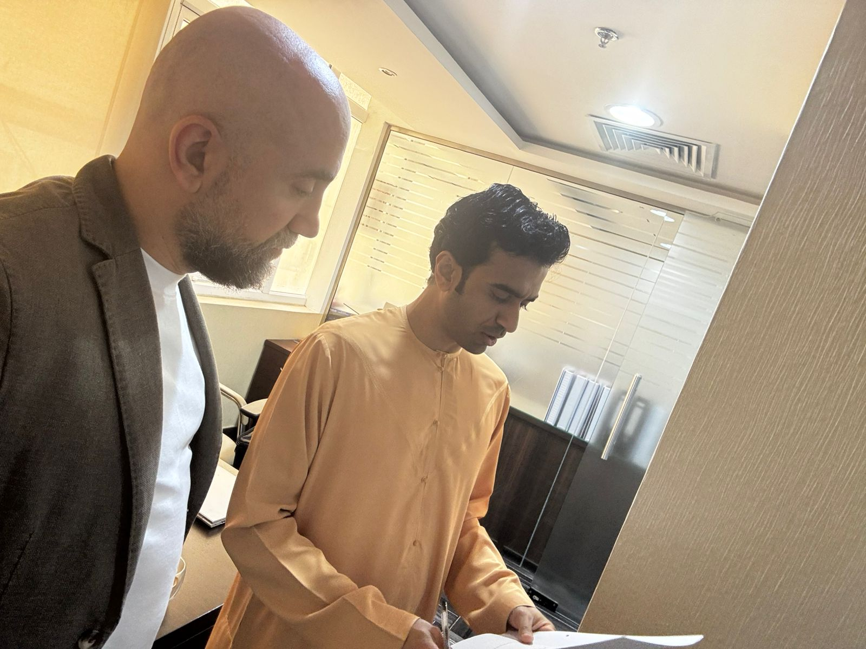
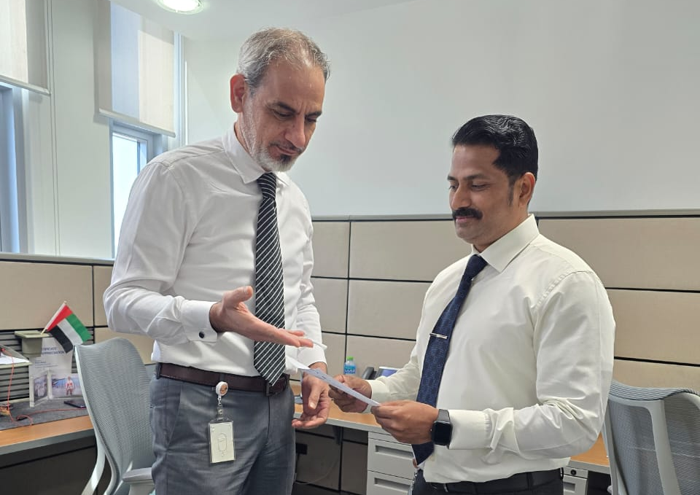
Field Survey
Outcome:
Developed Sample Survey Strategy with 10 Questions
20+ Students Feedback Collected
Identified Top Improvement Opportunities
Identified pain points
Developed Strategy for Improving Students Learning Satisfaction.

Slide 6

Lean Six Sigma - Fishbone Analysis For Improving Student’s Learning Experience
Assessment
Student Engagement
Administration
Facilities
Curriculum
Teaching Quality
Outdated content
Lack of practical sessions
Inadequate coverage of emerging technologies
Poor alignment with industry needs
Lack of industry experience
Poor Communication Skills
Un-Engaging Teaching Method
Inconsistent
assessment standards
Delayed Results
Vague grading criteria
Lack of constructive feedback
Biased or inconsistent evaluations
Lack of clubs or tech communities
Poor mentorship availability
Limited opportunities for projects
Delay in resolving queries
Poor communication of schedules or changes
Inefficient course registration process
Slow Connectivity
Lack of access to software / tools
Negative
Improve Student Learning Experience
Active clubs and tech communities
Support
mentorship availability
Opportunities for projects
Forum for voicing Concerns
Timely resolving queries
Clear communication of schedules / changes
Efficient
course registration process
Connectivity
access to software / tools
Up-to-date content
practical sessions
coverage of emerging technology
alignment with industry needs
Industry Experience
Effective Communication
Engaging Teaching Methods
Fair assessment standards
Prompt Results
Transparent grading
Constructive feedback
Consistent evaluations
Positive
Assessment
Student Engagement
Administration
Facilities
Curriculum
Teaching Quality

Slide 7
Literature Survey
We have Studied multiple Research Papers
Students feedback analysis model using deep learning-based method and linguistic knowledge for intelligent educational systems.
https://link.springer.com/article/10.1007/s00500-023-07926-2
Can feedback from students to teachers improve different dimensions of teaching quality in primary and secondary education? A hierarchical meta-analysis
https://link.springer.com/article/10.1007/s11092-024-09450-9

Slide 8
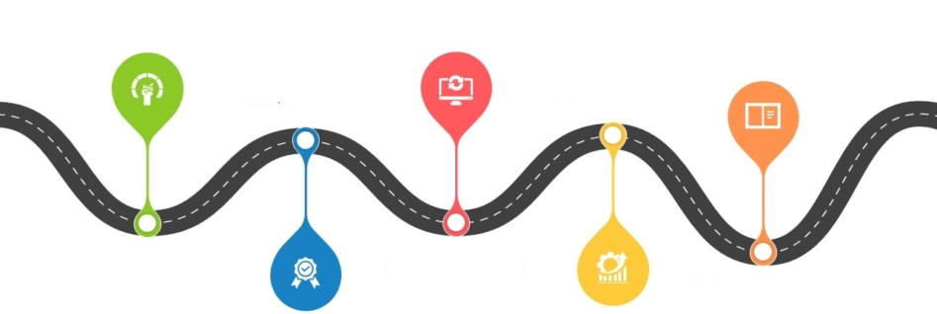

POWER App Road mAP Continuous Improvement
Foundation & Assessment
Standardization & Technology Integration
Growth & Diversification
Excellence & Expansion
Leadership & Sustainability
Curriculum Review
Audit all existing programs for relevance and quality.
Align with current industry standards and job market needs.
Staff Development
Conduct skill gap analysis.
Begin monthly faculty training workshops.
Student Services
Launch feedback mechanisms (surveys, suggestion boxes).
Improve counseling and career guidance support.
Marketing
Revamp website and social media presence.
Start local outreach campaigns
Digital Transformation
Implement a Learning Management System (LMS).
Introduce blended learning models (online + classroom).
Quality Assurance
Set SOPs for teaching, grading, and attendance.
Launch internal audits and peer reviews.
Industry Connect
Form an advisory board with local employers and alumni.
Start guest lectures and site visits.
Placement Services
Establish a placement cell with employer tie-ups.
Provide resume building and interview prep workshops
Disseminate standardized metrics
New Courses
Launch job-oriented short courses and certifications.
Offer soft skills and language training.
Faculty Incentives
Introduce performance-based incentives and recognition.
Research & Innovation
Begin small-scale research, innovation, or student projects.
International Exposure
Initiate collaborations with global institutions for webinars or student exchange.
Accreditation
Apply for national or international accreditation (e.g., ISO, NAAC).
Branch Expansion
Explore satellite campuses or online expansion.
Alumni Network
Form a strong alumni association for mentoring and fundraising.
Advanced Facilities
Set up smart
classrooms,
Labs &
innovation hubs.
Thought Leadership
Host conferences, seminars, and publish journals.
CSR & Community Engagement
Offer free or subsidized training to underserved groups.
Sustainability
Go green with energy-efficient buildings and paperless operations.
Recognition
Apply for awards, rankings, and government partnerships.
4
5
1
3
2

Slide 9






Thank You!
We respect your valuable time, If you have any questions, please reach us

